Slide 1
The Role of Instructional Leaders in the NMP
Texas Community College Instructional Leaders
October 10, 2014
an initiative of the Charles A. Dana Center and the
Texas Association of Community Colleges
Notes:
Put on tables:
Session agendas
Parking lots

Slide 2
The New Mathways Project
A systemic approach to improving student success by reforming developmental and gateway mathematics based on four fundamental principles:
Multiple pathways aligned to specific fields of study
Acceleration that allows students to complete a college-level math course more quickly
Intentional use of strategies to help students develop skills as learners
Curriculum design and pedagogy based on proven practice
Notes:
Introduce NMP principles: 8 minutes
Transition from the discussion to the NMP principles: “The data shows us that we are addressing a large-scale problem that goes beyond our capacity as individual educators. We need to build better structures to support students for success. The New Mathways Project is a statewide project to do that.”
The NMP principles were designed to address key issues that researchers and practitioners have identified as important levers to increase student success.
Review the principles. The principles on the slide are shortened to enhance readability. Here are the full versions:
Multiple pathways with relevant and challenging mathematics content aligned to specific fields of study
Acceleration that allows students to complete a college-level math course more quickly than in the traditional developmental math sequence
Intentional use of strategies to help students develop skills as learners
Curriculum design and pedagogy based on proven practice
As you review the principles, tie them back to the discussion and to information you have about local innovations. Try to find opportunities to honor the local work.

Slide 3
Dana Center’s Role
Support colleges to implement the four principles by:
Helping create a positive policy environment
Offering training and technical assistance
Developing planning and implementation tools
Developing curricular materials

Slide 4
Update on the NMP
10 colleges implemented courses developed by the Dana Center in 2013 – 2014
9 additional colleges in Texas and 3 from other states implementing courses in fall 2014
17 universities have joined the NMP Transfer Champion Initiative
THECB approved policy change to allow greater flexibility in mathematics pathways
Dana Center is expanding NMP work into seven states

Slide 5
NMP Preliminary Enrollment and Completion 2013-2014
All information presented here is preliminary.
The information was complied by the Dana Center using data self-reported by the colleges.
Totals include the nine codevelopers and Trinity Valley College.
Our external evaluators, MDRC will be reporting the official enrollment and completion numbers in (March 2015) based on data verified by THECB.

Slide 6
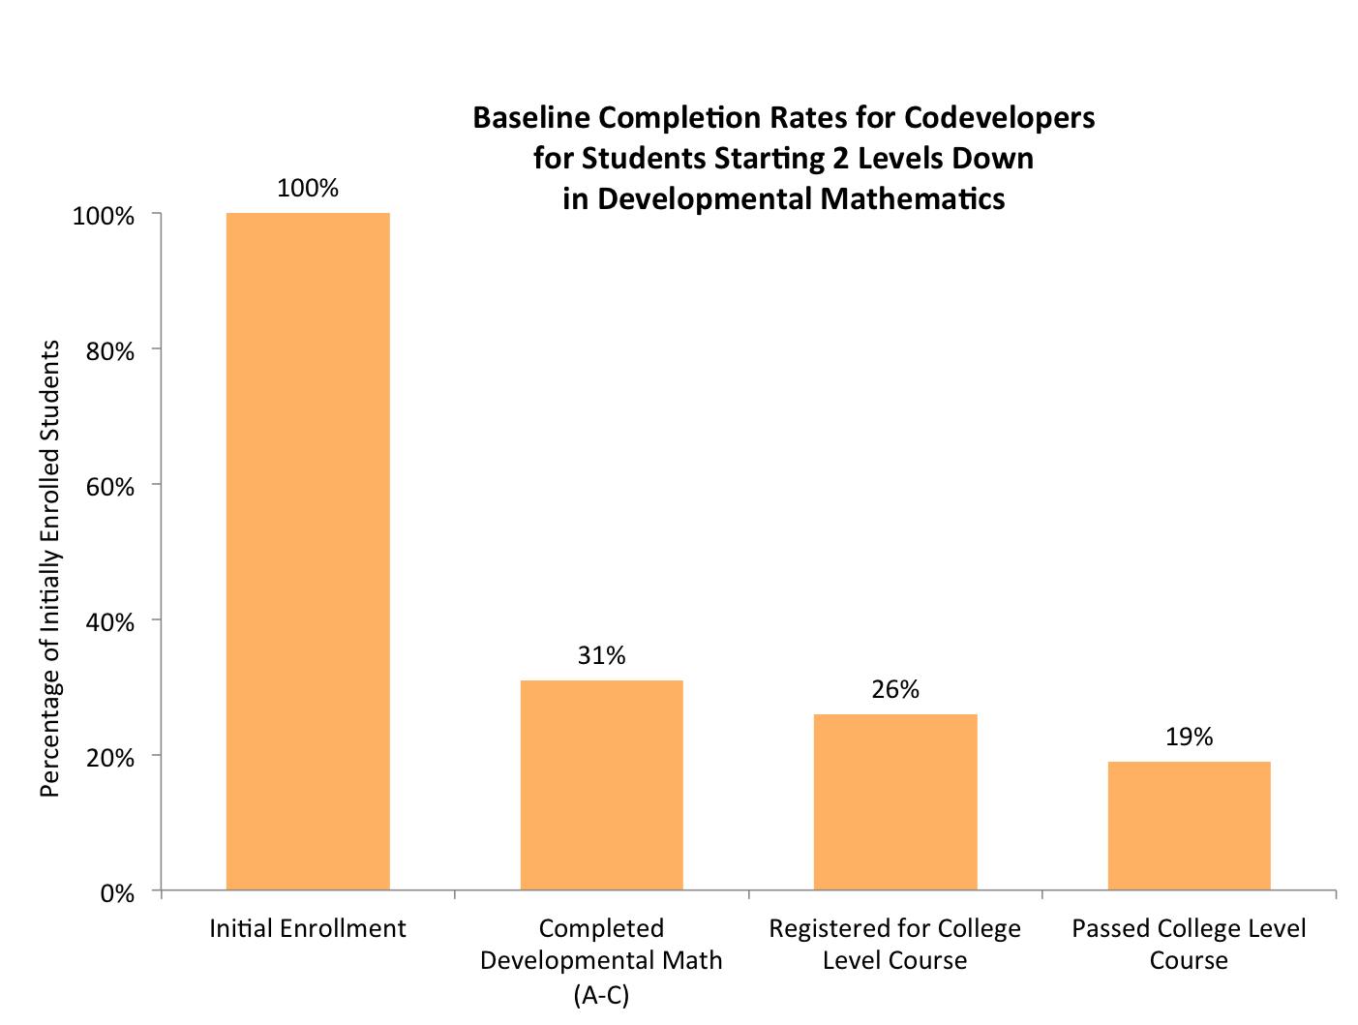
Historical Gateway Course Completion Prior to NMP Implementation
Notes:
Over the course of two years.
Anyone who started 2 Levels down in Fall 2010, including students who reached that point through testing and coursework.
Information is taken from the persistence tool which colleges provided
More than half of these students, completed developmental mathematics through testing and not developmental coursework.

Slide 7
Who are the students behind the data?
“My past experiences with math have stopped me from pursuing my education further, sooner. After I took that first developmental class that I failed out of, I took a nine-year ‘break’ from college. I’ve wanted to go, but every time I looked at the degree plans it says college algebra. Just seeing that, automatically I felt like I can’t do this.”

Slide 8
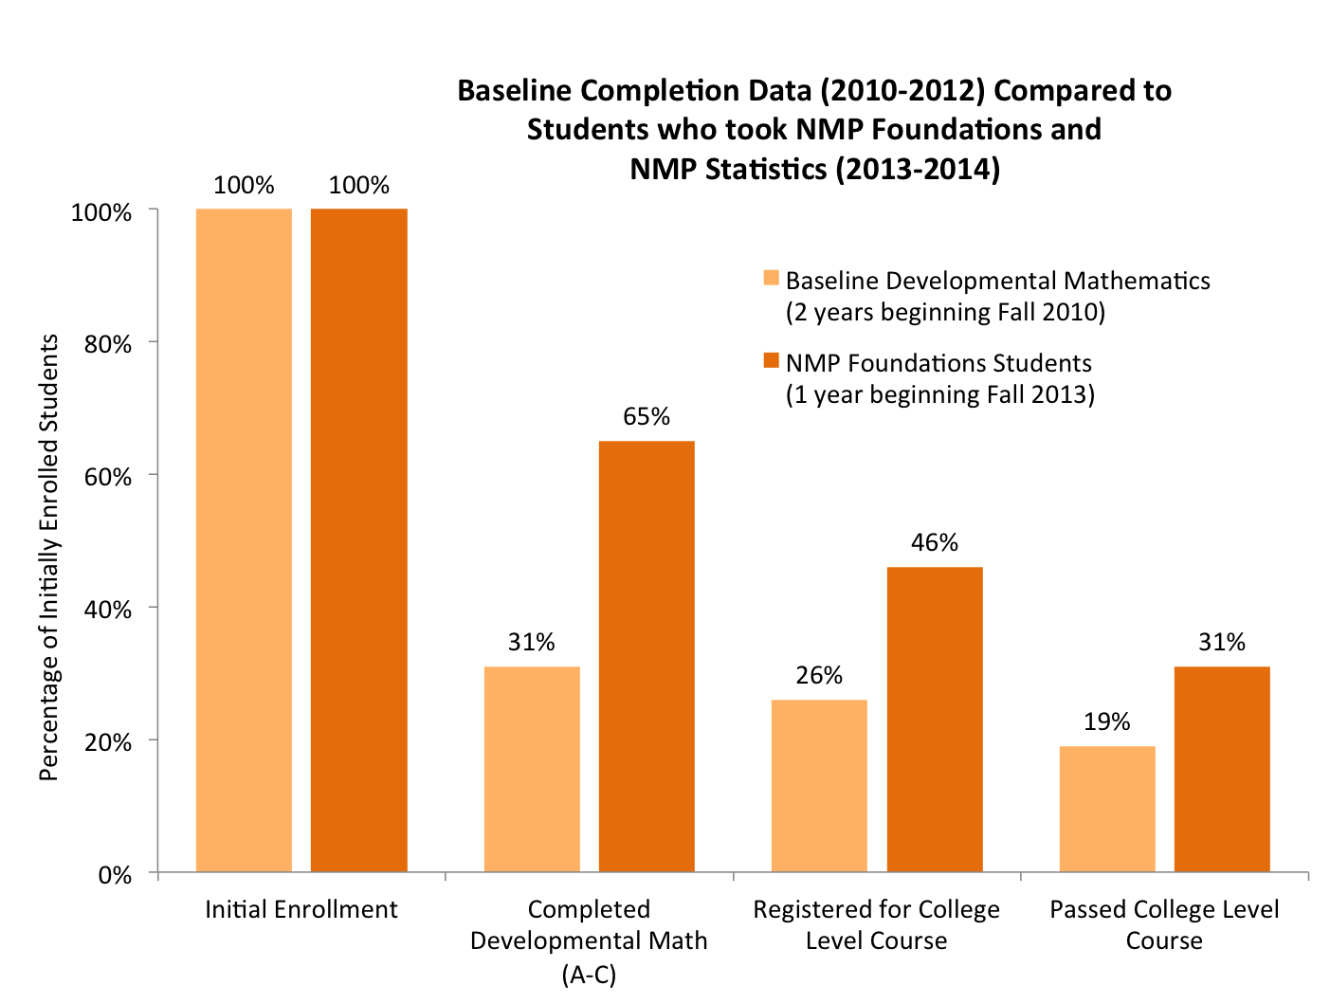
NMP Preliminary Enrollment and Completion 2013-2014
Notes:
This chart compares the baseline data to NMP passing rates for NMP foundations followed by any other course: including NMP statistics, another statistics course, technical math, etc.

Slide 9
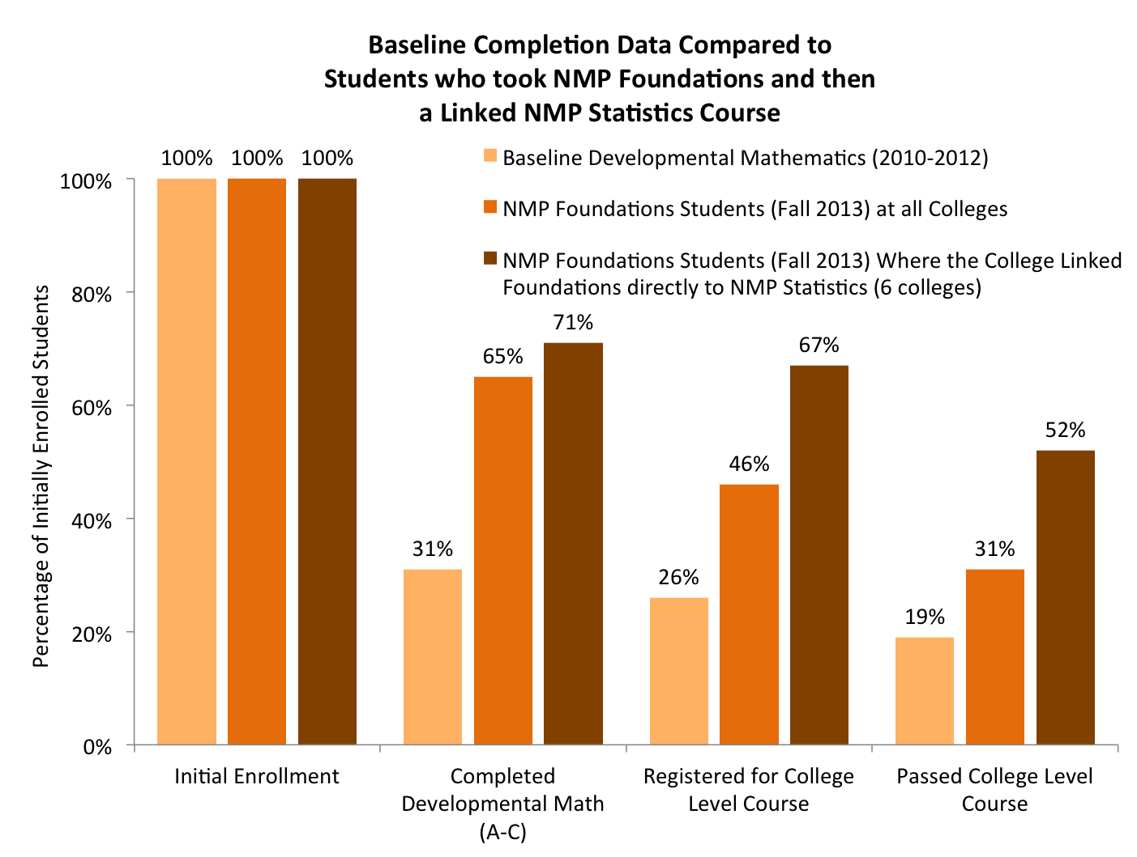
NMP Preliminary Enrollment and Completion 2013-2014
Notes:
The burnt orange line represents the completion rates for colleges who followed the complete model. This included Foundations linked with Frameworks and then an NMP statistics class where students were enrolled directly or strongly encouraged to enroll.
Five colleges had more than 50 percent of the students who began in Foundations complete NMP statistics with an A, B, or C within one year.
(6 colleges)

Slide 10
Who are the students behind the data?
“I absolutely hated math; I wanted nothing to do with it. And now it’s actually becoming fun. It’s a language I’m finally starting to understand. I took Algebra 1A seven times in high school...and now...I walk next month. I graduate with my Associate’s degree. I got accepted into San Houston. A lot has changed because of this class.”

Slide 11
The Role of Leadership
President
Set the charge
Connect to institutional mission and strategic plan
VP of Academic Affairs
Deans
Support effective planning process
Support staff and faculty
Department Chairs
Program Coordinators
Promote faculty engagement
Identify and support the champions

Slide 12
Effective Planning Processes
Engage a strong team that represents key stakeholder groups
Consider how work will align or conflict with other projects
Examine institutional data, context and culture before making decisions
Honor previous work, build from strengths
Ask tough questions when needed
Plan for scale

Slide 13
Support staff and faculty
Recognize and plan supports for the amount of work required
Honor and highlight work
Listen to concerns

Slide 14
Promote faculty engagement
Create opportunities for faculty to actively engage
Authentically ask for and use feedback
Communicate about how feedback is used and decisions are made
Consider ways to include adjuncts, faculty from other disciplines

Slide 15
Identify and support champions
Provide opportunities for professional learning
Promote leadership roles
Ensure representation of all groups of faculty

Slide 16
NMP resources and activities
NMP Implementation Guide
Faculty professional learning activities
Curriculum development
Policy work

Slide 17
Upcoming Events
Webinar: NMP STEM-Prep Pathway
October 30, 2:00 – 3:00 Central
Summarize the work faculty have done with the Dana Center to design the STEM-Prep Pathway
New Faculty Workshop
November 7-8, Austin
For faculty who are teaching Dana Center Courses in the Spring and have not had previous training.

Slide 18
Contacts
Amy Getz: getz_a@austin.utexas.edu
To receive monthly updates or request information about events, contact us at: mathways@austin.utexas.edu
Notes:
Do we need to add Jenna? Tina?

